Slide 1
Building serverless applications with IBM Functions
Sudharshan Govindan
Developer Advocate
sudharshan.govindan@in.ibm.com
@sudhargovindan

Slide 2
Serverless developers focus more on code, less on infrastructure
Increasing focus on business logic
Functions
VM
VM
Containers
VM
Virtual machines
Bare Metal
Decreasing concern (and control) over stack implementation
Notes:
Why is it named as Serverless? Is there really no Server involved, then how is the code rendered to Web ?

Slide 3
















Microservices can be hard to manage at scale
Region A
Region B
Monolithic Application
Break-down into microservices
Make each microservice HA
Protect against regional outage

Slide 4
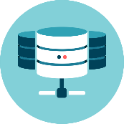




Emerging workloads are a good fit for event-driven programming
Execute logic in response to database change
Perform analytics on sensor input messages Provide cognitive computing via chatbots
Schedule tasks performed for a short time Invoke autoscaled APIs and mobile backends

Slide 5
New cost models more accurately charge for usage
Cloud resource cost better matches business value gained
Memory allocated (MB)
Instances executing simultaneously (count)
Not a silver bullet, but this can result in substantial savings for many workloads
Time executing (milliseconds)

Slide 6

OpenWhisk enables these serverless, event-driven workloads
Provides serverless deployment and operations model
Runs code only on-demand on a per-request basis Optimized utilization, fine-grained metering at any scale
OpenWhisk is a cloud platform that executes code in response to events
Flexible, extensible, polyglot programming model
Open source and open ecosystem (Apache Incubator)
Ability to run in public, private, and hybrid models

Slide 7












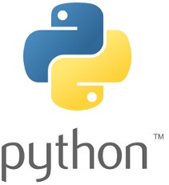

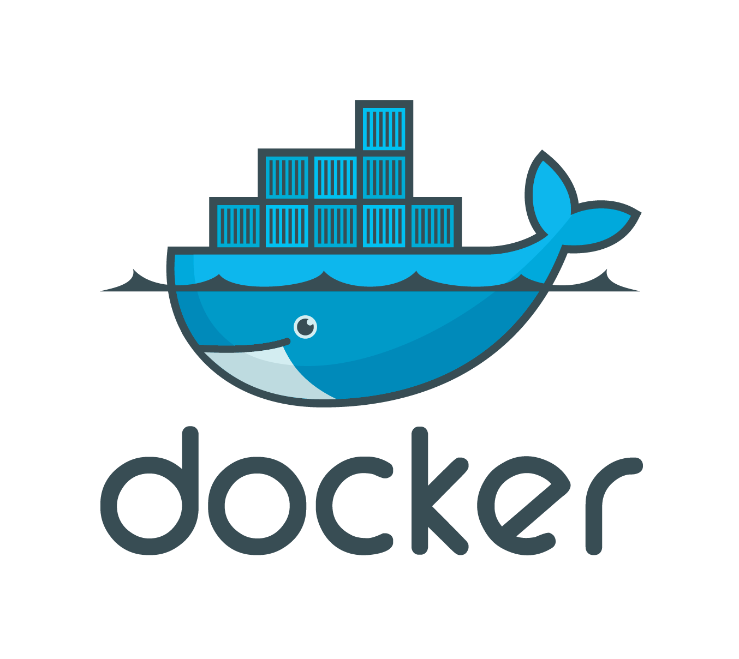









Developers work with triggers, actions, rules, and packages
Data sources define events they emit as Triggers.
T
R
Developers map Actions to
Triggers via Rules.
A
Packages provide integration with external services.
P

Slide 8

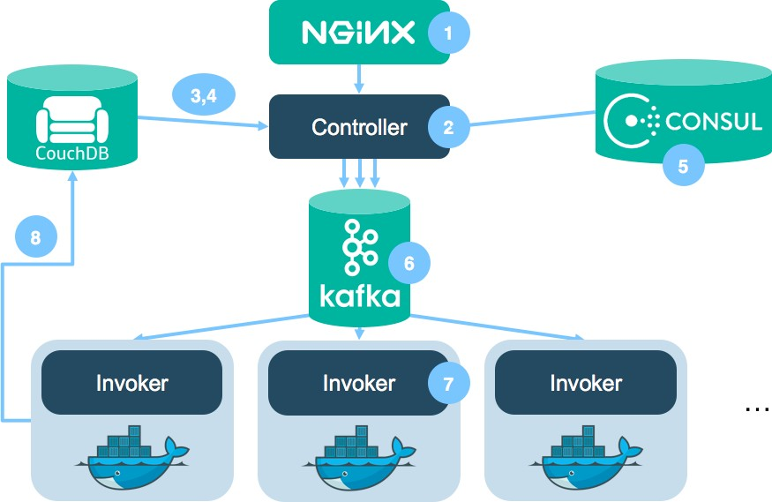

OpenWhisk is built on solid open source foundations
Apache Incubator

Slide 9
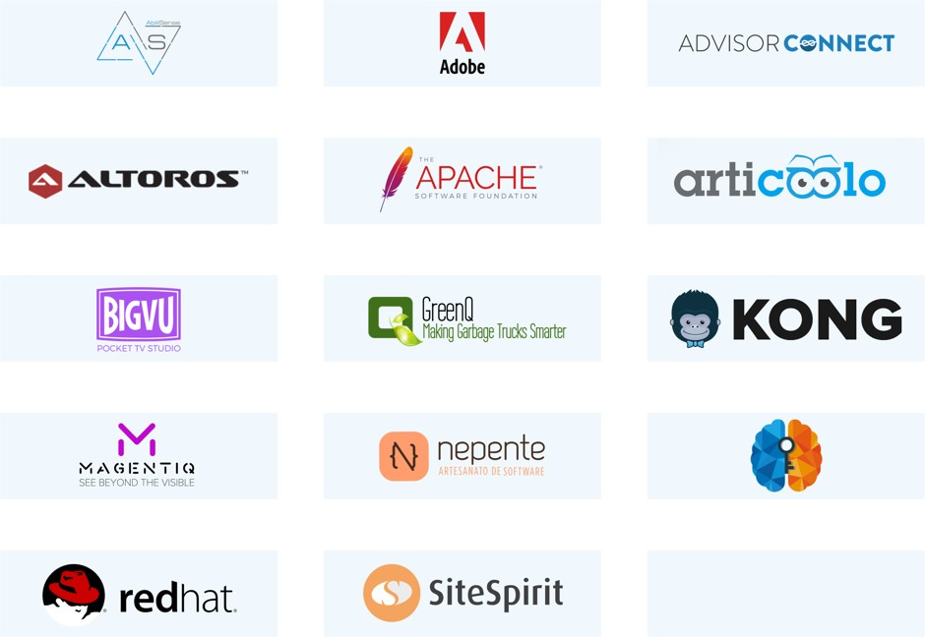


The OpenWhisk ecosystem is growing
Apache Incubator

Slide 10
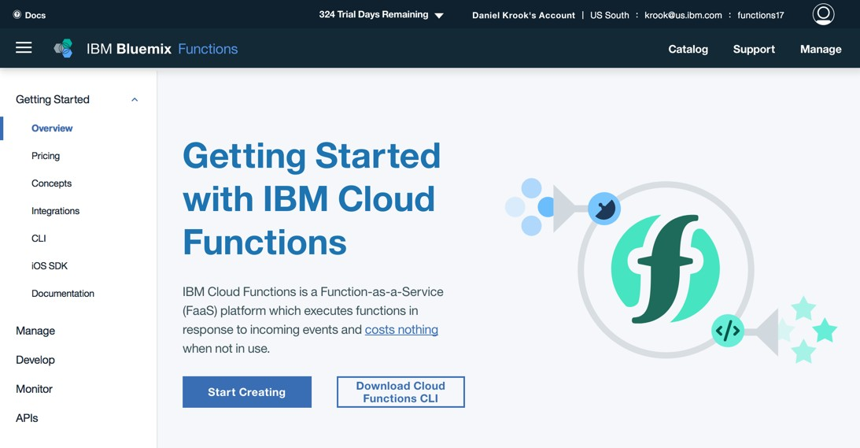
Use Apache OpenWhisk via IBM Cloud Functions: bluemix.net/openwhisk
wsk CLI

Slide 11
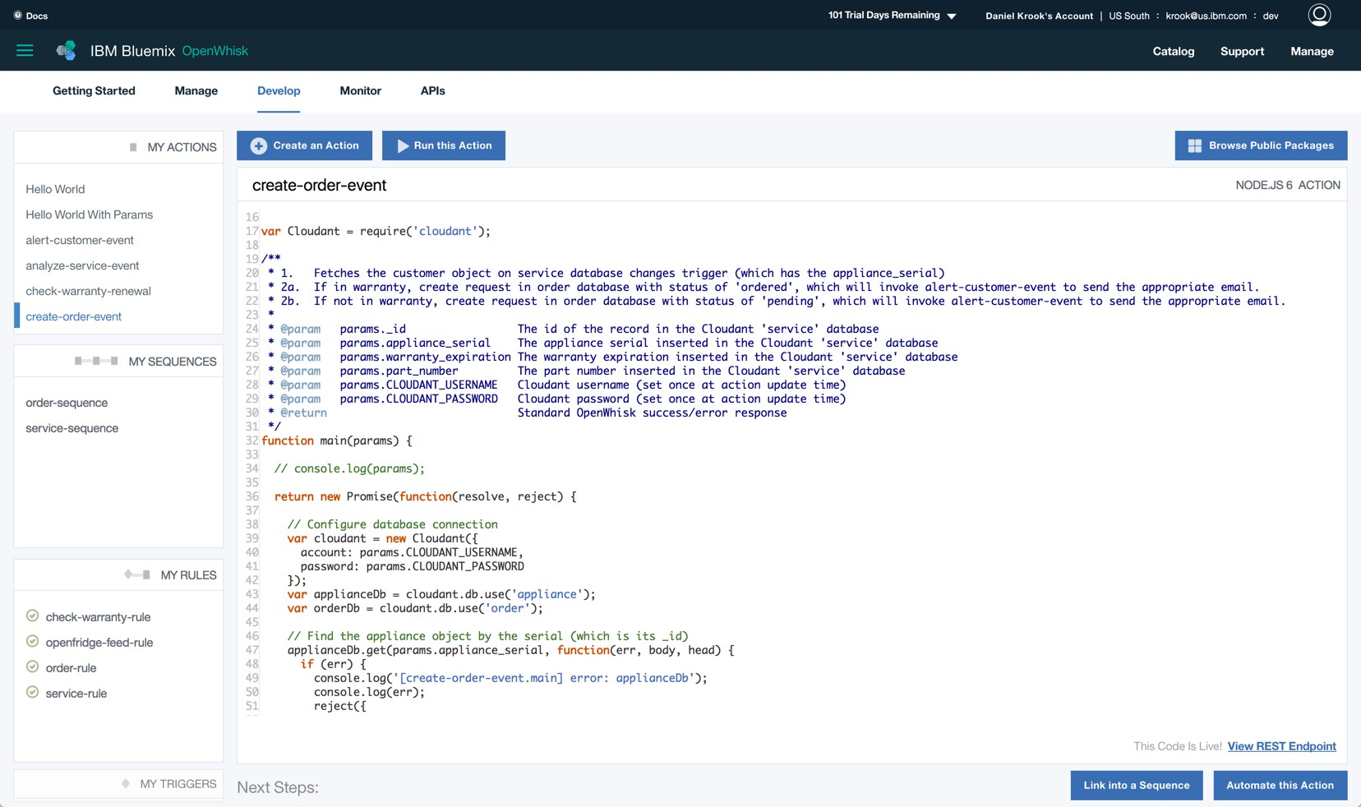
IBM Cloud Functions provides management, tooling, and monitoring

Slide 12
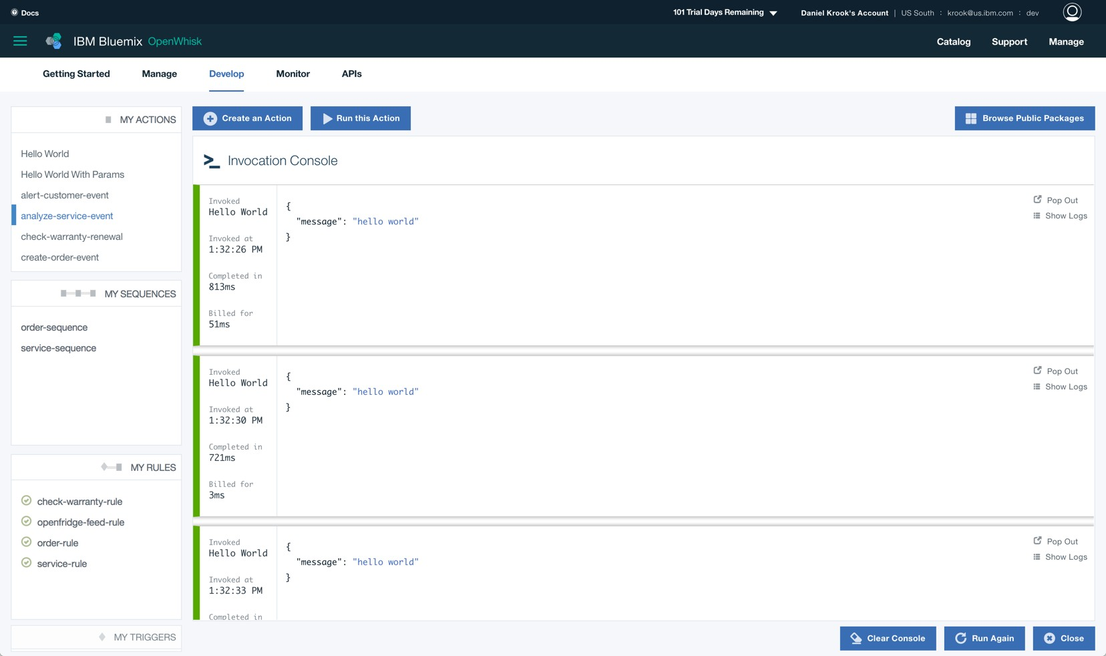
IBM Cloud Functions provides management, tooling, and monitoring

Slide 13
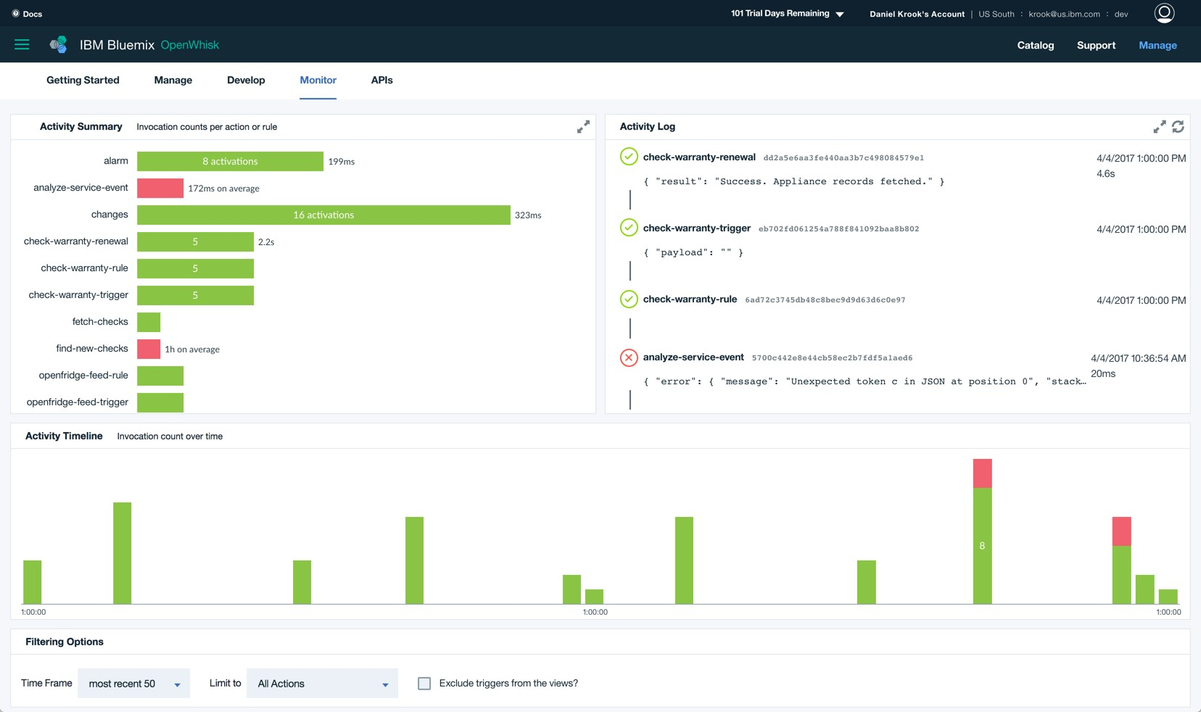
IBM Cloud Functions provides management, tooling, and monitoring

Slide 14
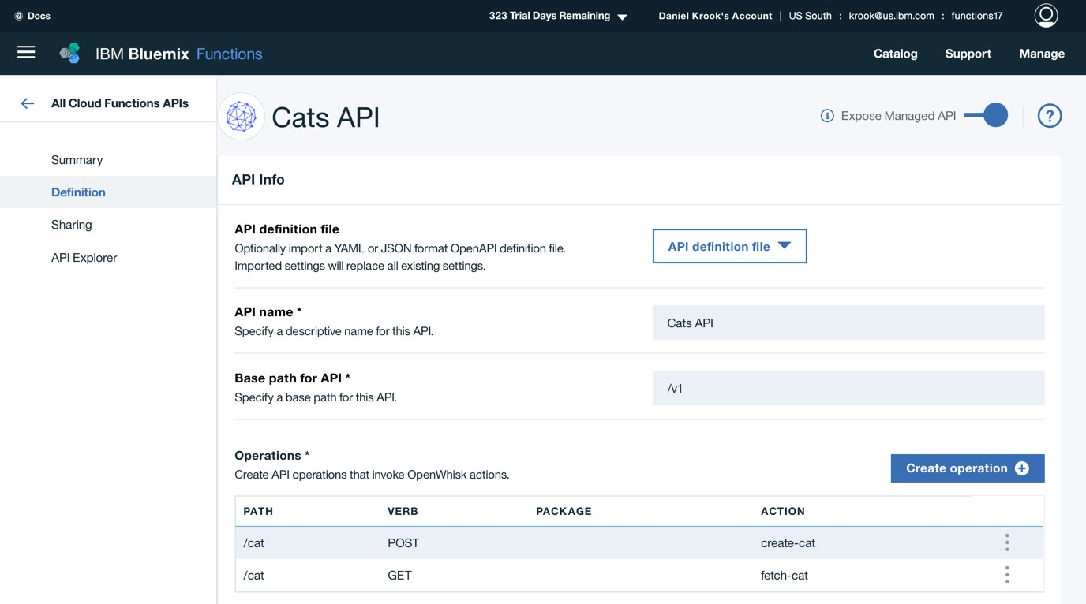
IBM Cloud Functions also provides included API gateway integration

Slide 15
Apache OpenWhisk programming model
© 2017 IBM Corporation l Interconnect 2017

Slide 16













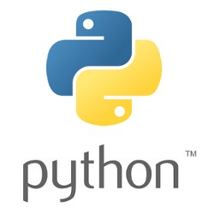



Developers work with packages, triggers, actions, and rules
Package (feed)
Data sources define events they emit as Triggers
P
T
Trigger (event)
Packages provide integration with external event sources
Results
Developers map Actions
to Triggers via Rules
Action (function)
A
R
Rule (map)

Slide 17














Triggers
T
A class of events that can occur
Data changes
User input
Social events
Device readings
Location updates

Slide 18


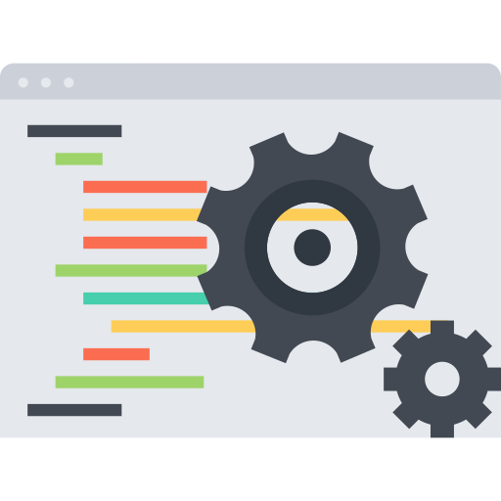


Actions
A
Code that runs in response to an event (that is, an event handler)

Slide 19


Actions
A
Can be written in a variety of languages, such as JavaScript, Python, Java, PHP, and Swift
function main(params) {
return { message: 'Hello, ' + params.name + ' from ' + params.place };
};

Slide 20





Actions
A
Or any other language by packaging with Docker

Slide 21

















Actions
A
Can be composed to create sequences that increase flexibility and foster reuse
A_{A} := A₁ + A₂ +
A₃
A_{B} := A₂ + A₁ +
A₃
A_{C} := A₃ + A₁ +
A₂

Slide 22







Rules
R
An association of a trigger to an action in a many to many mapping.
R
:=
T
A

Slide 23
















Packages
P A shared collection of triggers and actions
read write changes
A
A T
A
translate
A
forecast
Open Source
post topic
Third Party
Yours
myAction myFeed
A
T
A
T
T
commit

Slide 24
Apache OpenWhisk in action
© 2017 IBM Corporation l Interconnect 2017

Slide 25












OpenWhisk awaits events, fetches mapped code, runs it in a container
1
T
Trigger
2
A
Pool of actions
OpenWhisk Engine
JS
Swift
Docker
3
A
A
A
Running action
Running action
Running action

Slide 26
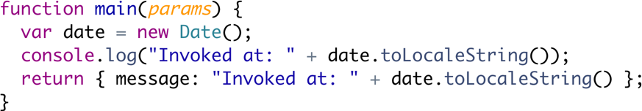







Demo 1: Your first trigger, action, and rule
$ wsk activation poll
$ wsk action create handler handler.js
1
T
$ wsk action invoke --blocking handler
1. Cron syntax alarm
Trigger
$ wsk trigger create every-20-seconds \
--feed /whisk.system/alarms/alarm \
--param cron "*/20 * * * * *" \
--param maxTriggers 15
2
A
$ wsk rule create \ invoke-periodically \ every-20-seconds \ handler
Running action
2. Log the current time

Slide 27
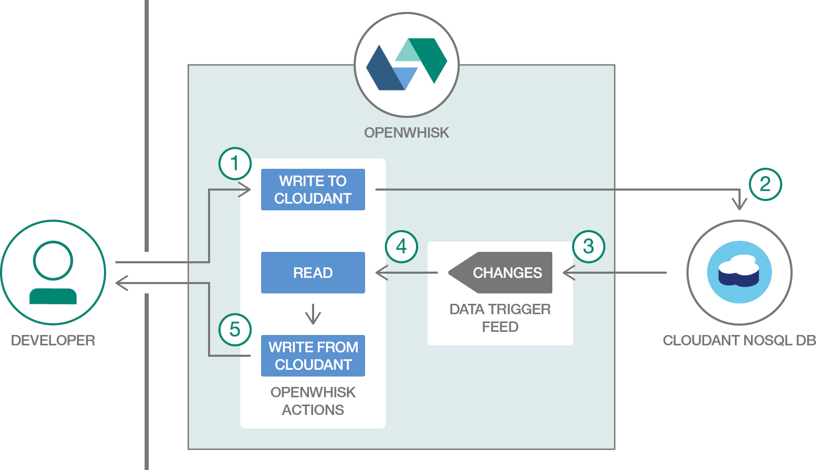
Demo 2: Database change triggered action

Slide 28
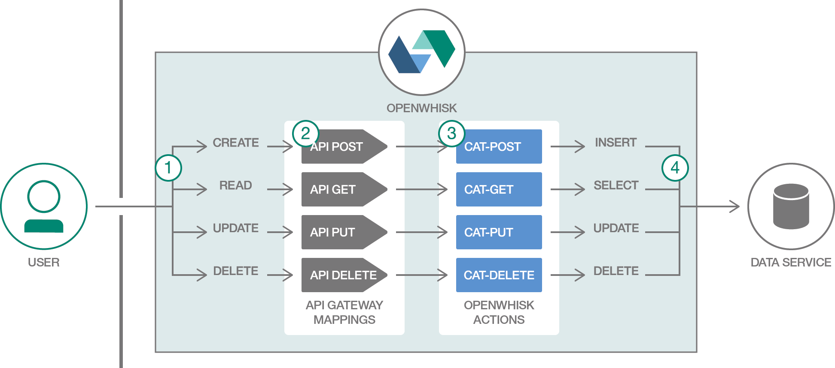
Demo 3: HTTP API request triggered action

Slide 29
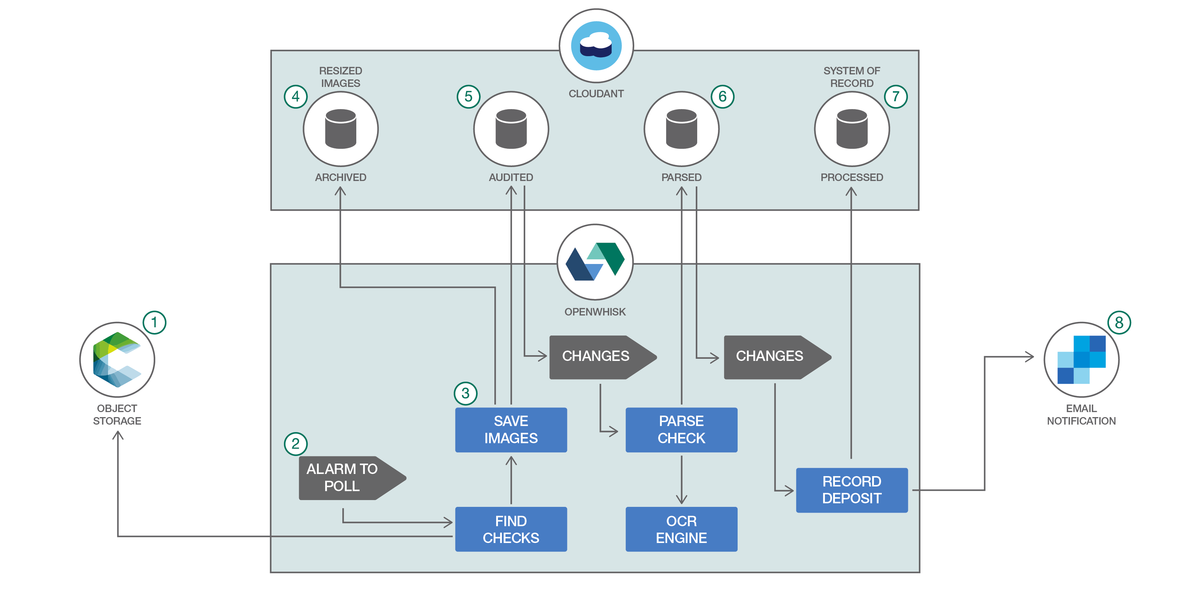
Other simple apps, working solutions, more complex uses

Slide 30



Get started with Cloud Functions, or explore the open source project
Managed OpenWhisk with IBM Cloud Functions bluemix.net/openwhisk
Delivered as
Open source via Apache openwhisk.org
github.com/openwhisk
slack.openwhisk.org twitter.com/openwhisk medium.com/openwhisk

